Slide 1
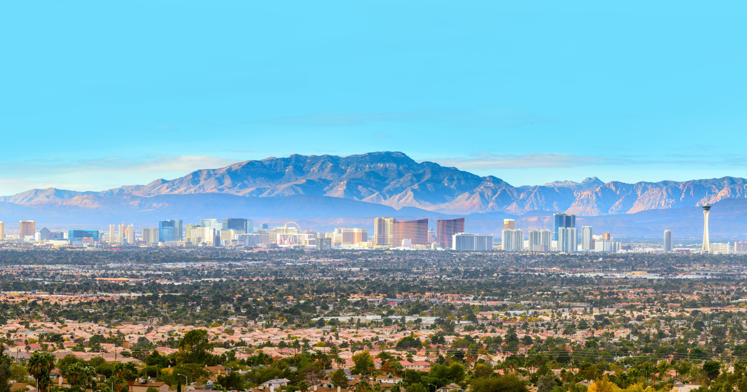
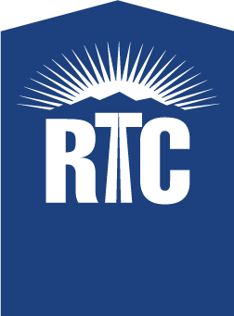
Regional Transportation Commission of Southern Nevada
Funding our Future
Notes:
Good morning, and thank you for having me here today. I’m excited to tell you about some of the RTC’s recent projects and initiatives. But before I provide you with this update, I would like to give you a quick reminder of who we are…

Slide 2

Evolution of the RTC
1965 – Nevada Legislature creates the RTC
1981 – RTC becomes a Metropolitan Planning Organization
1983 – Nevada Legislature enables RTC to provide transit
1992 – RTC launches new public transit system
2004 – RTC becomes regional traffic management agency
2015 – RTC becomes Southern Nevada Strong administrator
2016 – RTC launches public bike share system
Notes:
Here is a summary of milestones:
1965 – Nevada Legislature creates the RTC
1981 – RTC becomes a Metropolitan Planning Organization
1983 – Nevada Legislature enables RTC to provide transit
1992 – RTC launches new public transit system
2004 – RTC becomes regional traffic management agency
2015 – RTC becomes Southern Nevada Strong administrator
2016 – RTC launches public bike share system

Slide 3

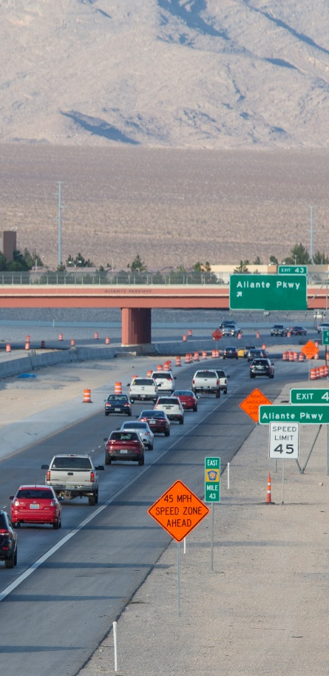
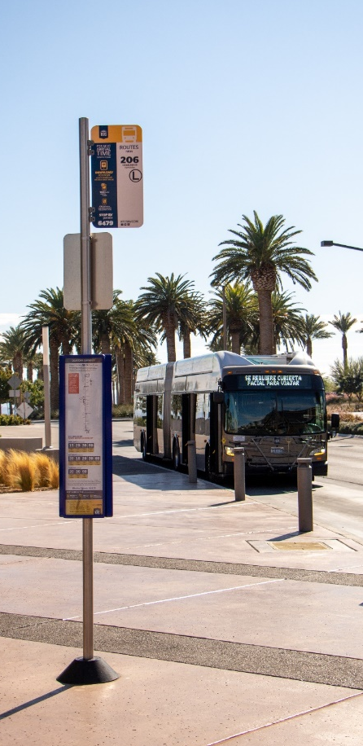


Who We Are
Planning
Roadway Funding
Transit
Traffic Management
Bicycling
Notes:
At the RTC, our fundamental role is to connect people. You may know us for transit, roadways, or cycling, but we touch every cornerstone of this community: from the bus you take and the road your drive on, to the traffic light that maintains order, and the bike lanes and sidewalks that provide safe travel options.
So what does that look like?
The RTC is the regional planning agency, otherwise known as the Metropolitan Planning Organization (MPO), and we work with all the local jurisdictions to fund and plan roadways.
We are the transit provider for the region. And we are responsible for traffic management, coordinating traffic signals, dynamic message signs and ramp meters.
Finally, we oversee the bike share system in downtown Las Vegas, among other cycling initiatives.
We are unique with all of these operations under one roof, and that enables us to be more efficient and effective as the transportation agency for Southern Nevada.

Slide 4
FY 2024 Funding Sources
MILLIONS
Sales Tax
Fuel Taxes
Grants
Fares
Bond Proceeds
Other
Total
$309.7
$210.9
$165.8
$62.1
$182.3
$28.7
$959.5
Notes:
Here’s a quick look at how we are funded from Fiscal Year 2024.
Biggest Budget Historically
Record-setting inflation during and after the Pandemic causing increases in Labor and Supply Costs
Sales Tax 291.4
Fuel Taxes 203.5
Grants 142.4
Fares 56.7
Bond 15.6
FY24 Funding Sources
Sales Tax $309.7
Fuel Taxes $210.9
Grants $165.8
Fares $62.1
Bond Proceeds $182.3
Other $28.7
TOTAL $959.5
FY24 Others includes:
Fund 50 Reduction in Beg. Fund Balance $5
Medicaid Reimb 8.7
FAST FMS Reimb 3.7
Transit Adv 4.0
Complete Streets 0.5
Other small reimb 1.2

Slide 5
FY 2025 Total Funding Sources
Sales Tax
Fuel Taxes
Grants
Fares
Bond Proceeds
Fund Balance
Other
Total
$327.3
230.1
201.2
59.4
196.7
66.8
20.9
$1,102.4
MILLIONS
Notes:
FY24 Total Sources $959.5 million
Record setting inflation after the Pandemic Causing increases in Labor and Supply Costs
Sales Tax 309.7
Fuel Taxes 210.9
Grants 165.8
Fares 62.1
Bond Proceeds 182.3
Other 28.7
Fund Balance mainly due to the stimulus funds received from the federal gov’t
FY25 Total Sources $1,102.4 million.
Sales Tax 327.3
Fuel Taxes 230.1
Grants 201.2
Fares 59.4
Bond Proceeds 196.7
Fund Balance 66.8
Other 20.9
FY25 Others includes:
Medicaid Reimb 9.3
FAST FMS Reimb 3.8
Transit Adv 4.0
Complete Streets 0.3
Other small reimb 1.2

Slide 6
Sales and Use Tax Revenue
MILLIONS $
PROJECTED
BUDGETED
‘16
‘17
‘18
’19
‘20
‘21
‘22
‘23
‘24
‘25
Notes:
FY24 projecting 3% increase FY25 budgeting 3% increase
FYTD through Dec = 3.06%
CC budget: 3.3%
This increases in sales and use tax revenue is offset by inflationary increases in Labor and Supply costs on the expense side.
FY2022 25.4% or $58M increase from FY2021,
FY2023 6.7% or $19M increase from FY2022,
Of the $327 million, $245.5 million is dedicated to Transit.

Slide 7
Fuel Tax Revenue
230.1
MILLIONS $
214.6
204.7
184.5
193.6
174.4
184.9
171.9
162.8
155.1
BUDGETED
PROJECTED
Notes:
While we have seen an increase in FRI extension due to inflationary increases, MVFT revenue almost remained flat from 2012 to 2025.
We have seen a continuous decrease in gallons sold within CC since 2022.
Fuel Tax Revenue Assumptions are consistent with Roadway Funding Model
Jet-A removed in FY22 Based on FAA audit

Slide 8
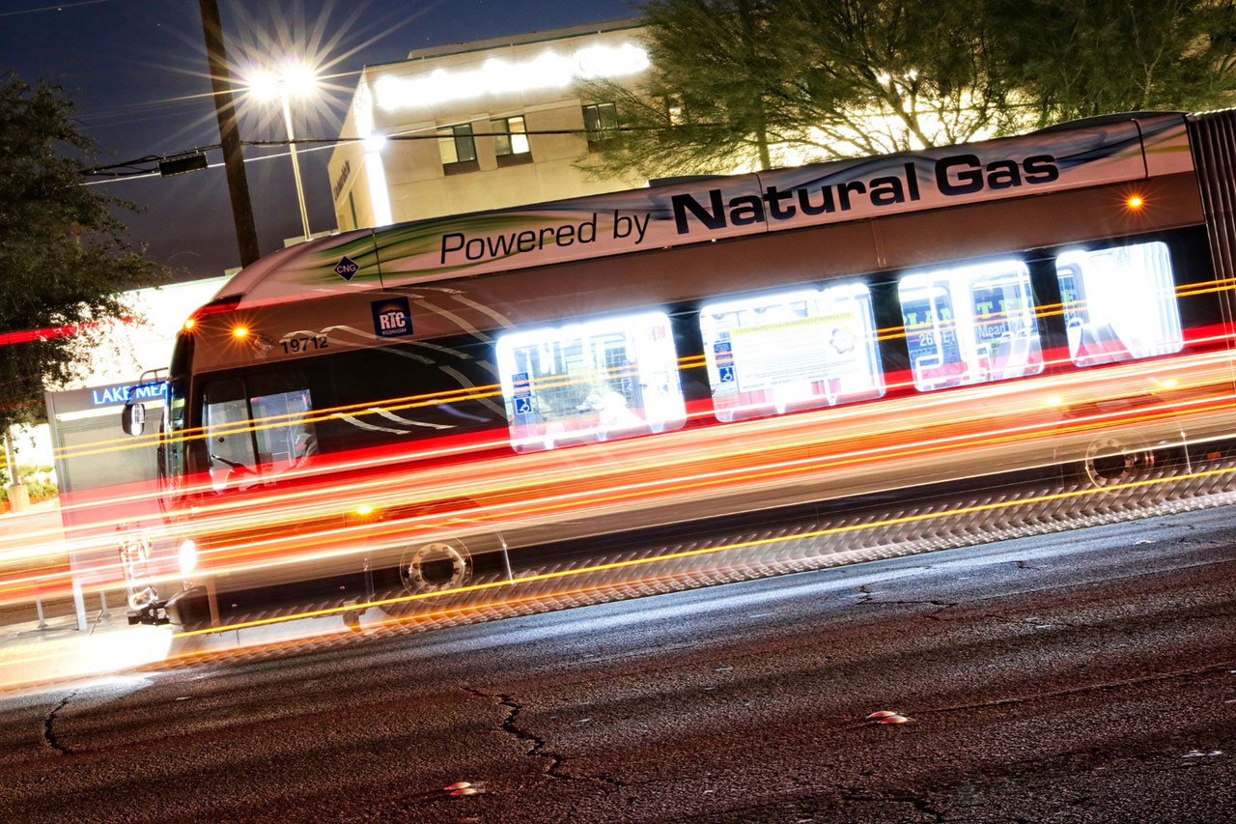
Transit Funding
Notes:
Now let’s talk mobility and public transit

Slide 9
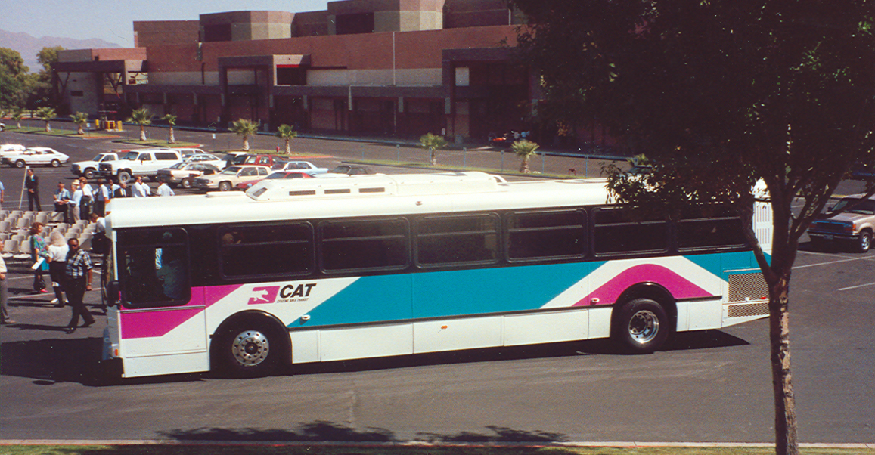
Public Transportation
1983 enabling legislation
1990 ballot measure – 0.25% sales tax (transit only)
1992 RTC launches new public transit system
2002 ballot measure – 0.25% sales tax (roadway & transit)
Notes:
The RTC was given authority via enabling legislation in 1983 to establish a public transportation system, but it wasn’t until 1990 that a local ballot measure was passed to create a funding source specifically for transit.
In December 1992, the RTC launched the Citizens Area Transit or CAT bus system (with these amazing colors no less).
As the community continued to experience rapid growth, local leaders recognized the need to increase transit funding to expand and enhance the bus service.
1983 enabling legislation
1990 ballot measure – 0.25% sales tax (transit only)
1992 RTC launches new public transit system
2002 ballot measure – 0.25% sales tax (roadway & transit)

Slide 10
FY 2025 Transit Funding Sources
Sales Tax
Capital Grants
Fares
Medicaid
Advertising
Fund Balance
Other
Total
$245.5
105.1
59.4
9.3
4.0
66.8
1.0
$491.1
MILLIONS
Capital Grant
21.4%
Notes:
FY2024 Transit Budget: $476.9
We are using $66.8M of Fund Balance which was mainly due to the federal government’s stimulus funds.
Sales Tax 232.3
Capital Grants 124.5
Operating Grants 32.0
Fares 62.1
Medicaid 8.7
Advertising 4.0
Reserve 12.3
Other 1.0
BACKGROUND
Fixed route contract cost
FY24 = 22.8% or $29M
FY25 = 9.8% or $15.3M
FY25 Service hour increase 45.5K or 2.51%
FY25 impact = $3M
FY25 Service hour rate increase = $2.85 (from $65.36 to $68.21) or 4.36%
FY25 Annual Service hour cost increase = $5.3M
FY25 Monthly fixed fee increase = $129,570 (from 43,423,439 to $3,553,010)or 3.78%
FY25 Annual fixed fee increase = $1.6M
FY24 $155.6M budgeted
Paratransit contract cost
FY24 = 9.6% or $4.6M FYTD though Oct 31, 2023 ridership is up $57K or 12.2% from PY
FY25 = 3.6% or $1.9M
Included in FY24 Projected is a $1.2M payment for PY services
Transit security cost
FY24 = 44.5% or $5.3M
FY25 = 33% or $5.8M
Increase # of armed security officers. This is based on the new competitively bid contract rate starting July 1, 2024.
We are continuously adding resources to provide a safe transit system for our passengers and drivers.
FY24 12.5M Budgeted
Transit Net Fuel Cost
FY22 = CNG 74c per GGE, Diesel $3.21, E-85 $
FY23 = CNG $1.13 per GGE, Diesel $3.83, E-85 $3.44
FY24 = CNG $1.95 per GGE, Diesel $3.44, E-85 $2.99, Hydrogen $18
FY25 = CNG $1.95 per GGE, Diesel $3.44, E-85 $2.99, Hydrogen $18

Slide 11
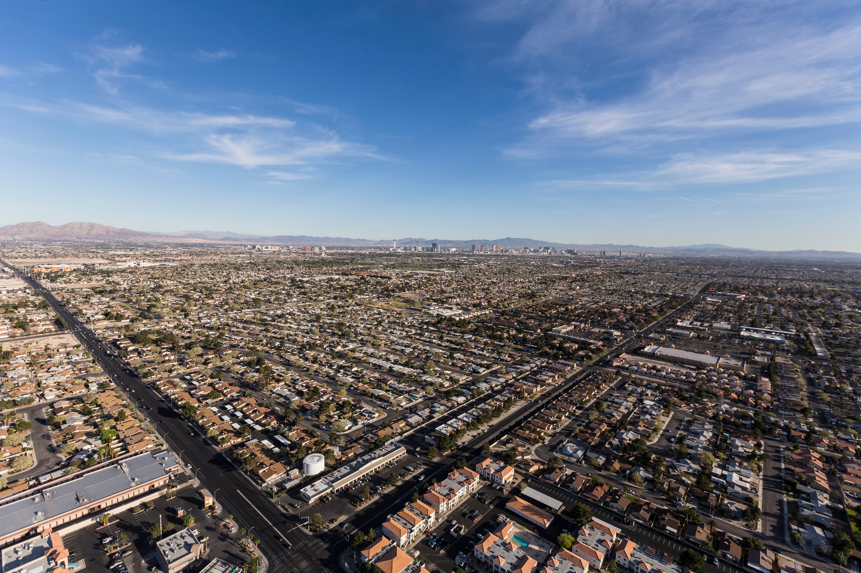
The RTC is Currently One of the Most Efficient Transit Agencies in the Nation
  #1
  HIGHEST
  FAREBOX
  RECOVERY RATIO
  #1
  LOWEST
  SUBSIDY
  #3
  LOWEST
  OPERATING COST
  14th
  BUSIEST
  BUS SYSTEM
5/7/2024
Source: National Transit Database
Notes:
In comparison to other bus systems nationwide, the RTC is the 14th largest, has the highest farebox recovery ratio, the lowest public subsidy, and one of the lowest operating costs in the nation.

Slide 12
How Transit Is Funded
Notes:
For the most part, RTC funding can be broken into two categories: transit and roadways.
Transit is primarily funded by sales tax and passenger fares, and we also use federal funds for transit’s capital programs.
BACKGROUND
Sales tax – O&M = $216,900,326 – 52.4%
Grants – capital costs (formula vs. discretionary) = $18,763,965 – 4.5%
Formula - $16,449,139 – 4%
Discretionary - $2,314,826 – 0.5%
In FY2022, we received and used stimulus funding to support O&M – FTA CRRSAA and ARP grant revenues = $117,526,697 – 28.4%
Passenger fares – O&M = $57,248,037 – 13.8%

Slide 13
Per Capita Investment In Transit
Total Expenditures | 2019 (Pre-Covid)
$80 to $259 Greater Per Capita Spending by Peer Agencies on Transit^{[1]}
Southern Nevada. Florida locations were included. Source: Federal Transit Administration; Applied Analysis. Note: Locations included large western metros most similarly positioned to RTC se of the similarity of its tourism economy to Nevada. Population refers to service area population. [1] With exception of Orlando, FL.
Notes:
When you look at the per capita investment in transit, we rank as one of the lowest with our peer agencies spending between $80 to $275 more per capita.
All the while, the cost of operating transit has continued to increase, similar to what we are seeing not only in our industry but other industries as well.

Slide 14
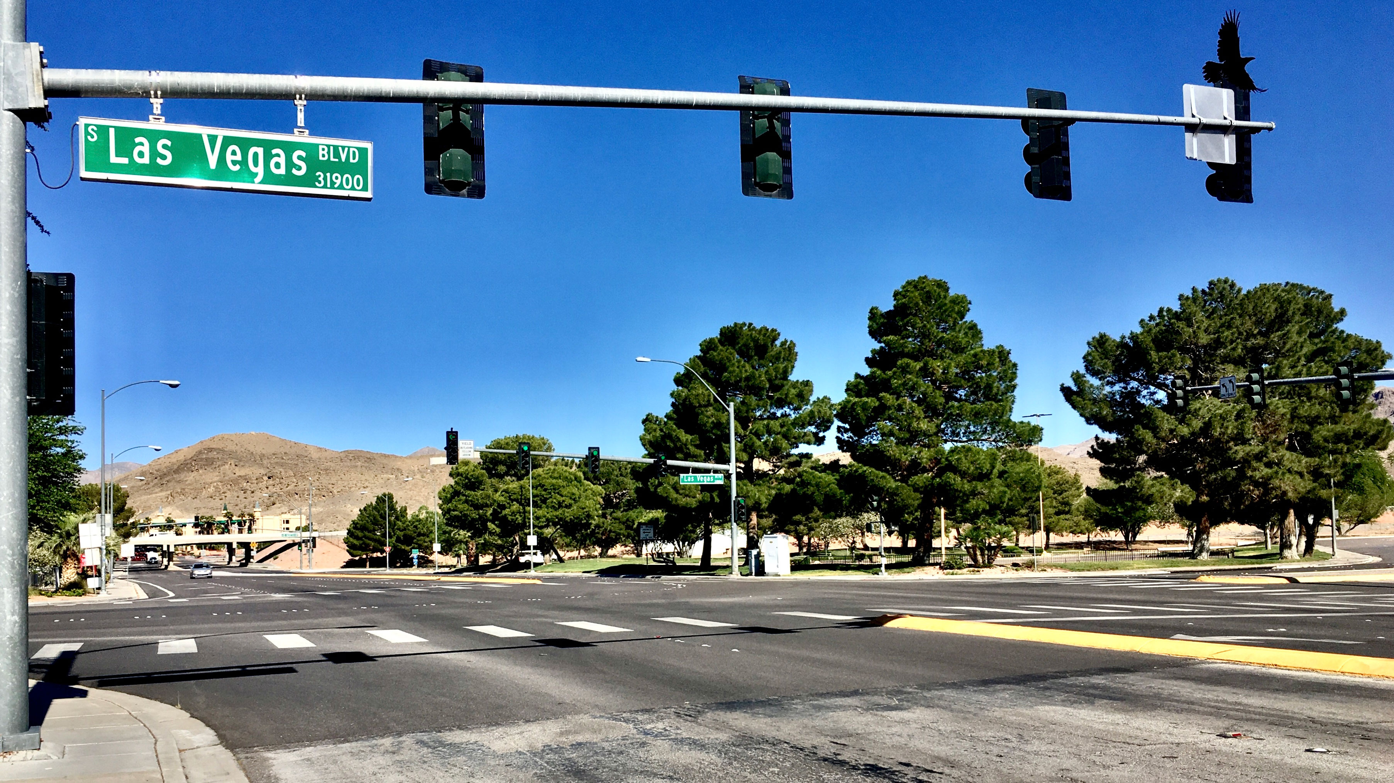
Transit Funding Challenges
Notes:
Next up, let’s talk about the future of transportation and the challenges ahead.
Despite these three revenue sources, a long-term sustainable funding source remains the largest challenge for our transit system.
Although we can operate service today, we are constrained by the level of service we provide due to the limited revenue that we receive. The next couple of slides will walk you through our transit challenge.
Updated via Marc 12/23

Slide 15
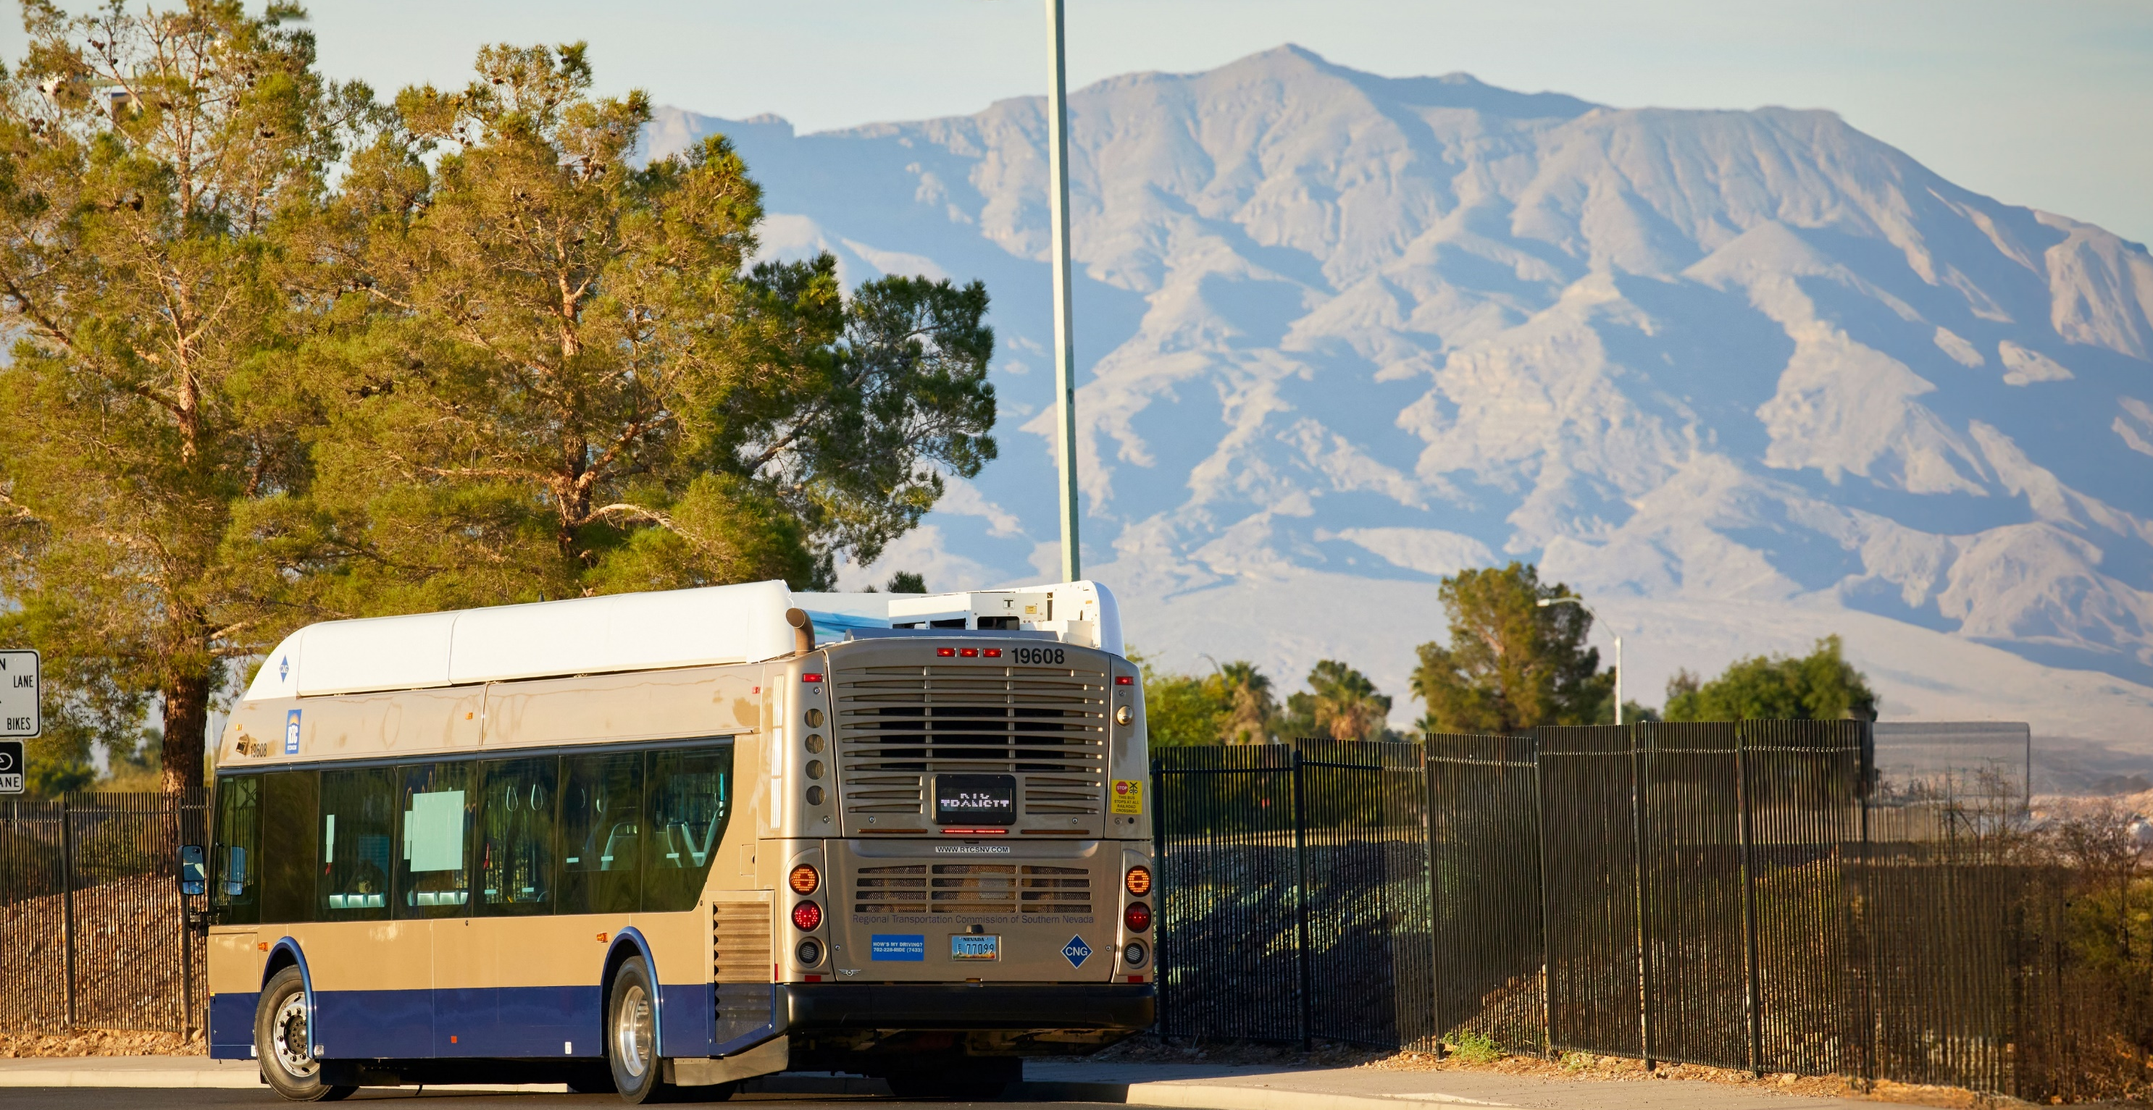



Transit Funding Challenges
  Increased
  Demand for
  Services
  Rising Cost
  in Providing
  Services
  Structural
  Imbalance
Notes:
We have not invested in transit in over 20 years. We currently receive a half cent of sales tax. Of this half cent, approximately 75 percent of the half cent goes to transit operations. So last year we received $231M in sales tax.
A lot that has happened in the last 20 years. Our population has doubled, our region has expanded geographically, with more housing, businesses, and schools, and demand for services has increased while our investment has stayed the same.
This has been our challenge as the cost of doing business increases and the demand for services are needed

Slide 16
RTC Cash Balance - Transit
Baseline
$164.0M Deficit
Notes:
This chart from our funding model represents our current and projected transit fund cash balance. The bars on the left represent revenues, the dark bars on the right represent expenditures the purple shaded area behind the bars represent the cash balance in this fund. It is important to note that in FY24 and FY26, we anticipate receiving federal grant reimbursements based on previous expenditures for our capital projects, demonstrating a surplus in revenues. [In other words, reimbursement for DDs, some 60ft vehicles and $40M for capital cost of contracting]
However, based on our assessment, what is more telling is that in FY27 through FY29 the deficit is large and expected to be around $164M in total. The funding deficit, as noted on this slide, continues into the outer years. As expected, we will continue to manage our budget and could potentially start reducing expenses as early as FY26 if we do not receive additional funding.
I’d also like to note that this chart does not include any future growth in mobility and much-needed enhancements to our transit system.
BACKGROUND (IF ASKED ABOUT THE STIMULUS FUNDING)
In fact, prior to the pandemic, we anticipated a $20 million deficit in Fiscal Year 2021. This deficit grew to $67 million post-COVID, and as a result, we cut nearly $77 million from our budget. We significantly implemented a hiring freeze, cut staff pay, and laid off or furloughed nearly 15 percent of our workforce, reduced our transit service, eliminated and postponed capital projects and cut contracts. If not for the federal stimulus funds during COVID, we would have made more severe cuts.
Thanks to federal stimulus funding, we received $303 million in federal aid to dedicate to transit and paratransit operational services. With this amount, we covered our shortfall prior to COVID, restored previously cut transit service, introduced new service and innovations, enhanced safety and security, brought back furloughed employees, and kept current transit staff employed.
Furthermore, the Infrastructure Investment and Jobs Act (IIJA) delivers historic funding for our nation’s transportation infrastructure and creates good-paying jobs for our community that will grow and diversify Nevada’s economy.
Based on historical apportionment of federal formula funds, we anticipate that RTC will receive a total of $311 million in formula funds for transit capital over the next five years, of which $80 million is new funding.
BACKGROUND – SOURCES AND USES
This slide represents transit’s sources of revenue and uses, or transit expenditures. In FY 23, we received $372M in revenues from sales tax, fare revenues and federal funding and expended ~$353M mostly attributed to the cost of providing transit, paratransit, senior and veteran services as well as the cost to replace buses when they reach the end of their useful life.
It is noteworthy to highlight the revenues received in FY21-22, where we drew down the last of the stimulus funds. I cannot emphasize enough that without the $304M dollars in stimulus funds that we received because of the pandemic; these slides would look very different.
FY20 ($24M), FY 21 ($149.7M), FY22 ($107.9M), & FY23 ($19.1M), Net Sources:
Federal stimulus grant ($303.5M)

Slide 17

Roadway Funding
Notes:
First, let’s talk about our roads.

Slide 18
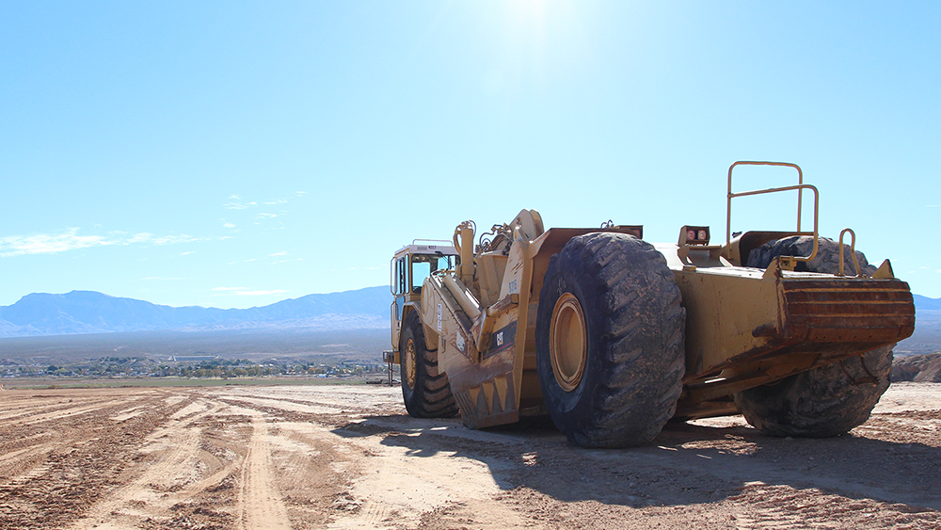
Roadway Milestones
1965 state legislation – 1 cent per gal. fuel tax
1990 ballot measure – 9 cents per gal. fuel tax (roadway only)
2002 ballot measure – 0.25% sales tax (roadway & transit)
2013 state legislation – Fuel Revenue Indexing
2016 ballot measure – Fuel Revenue Indexing 10-yr. extension
Notes:
Within the MPO, the RTC is in charge of roadway funding under our Streets & Highways Department. Roadways in Southern Nevada are funded by a combination of fuel tax, sales tax, and federal funds.
The RTC was established by state statute in 1965 to administer a 1 cent per gallon gas tax and since then, southern Nevada has incorporated other funding mechanisms.
1965 state legislation – 1 cent per gal. fuel tax
1990 ballot measure – 9 cents per gal. fuel tax (roadway only)
2002 ballot measure – 0.25% sales tax (roadway & transit)
2013 state legislation – Fuel Revenue Indexing
2016 ballot measure – Fuel Revenue Indexing 10-yr. extension

Slide 19
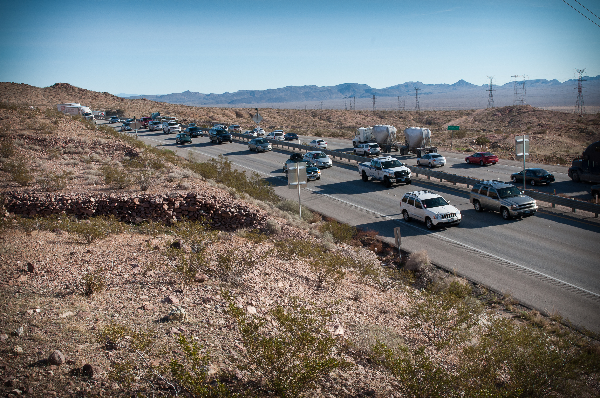



How Roads get Funded
  Motor Vehicle
  Fuel Tax
  Fuel Revenue
  Indexing
  Sales Tax
  0.125%
Notes:
Roadway funding makes it possible for the RTC and its member agencies (City of Las Vegas, City of North Las Vegas, City of Henderson, City of Mesquite, City of Boulder City and Unincorporated Clark County) to move forward with the planning and creation of transportation projects that benefit millions of Southern Nevada residents and visitors. These projects create jobs, put small businesses to work and improve the local economy.
Three main sources of roadway funding come from Fuel Revenue Indexing (FRI), Motor Vehicle Fuel Tax (MVFT) and sales tax collected in Clark County is used to fund roadway projects.

Slide 20
Producer Price Index
Notes:
The nearly $1.2 billion from the FRI revenue projections doesn’t just go to the RTC, it also goes to the State and Clark County for southern Nevada projects.
The FRI program will help address inflation, sustain jobs, and allow us to maintain and build transportation projects that will benefit Southern Nevada.
BACKGROUND
$409,877,528 for NDOT
$142,854,376 for Clark County
$606,812,695 for RTC
The $606 million coming to the RTC primarily goes directly to the county and cities. Unlike RTC Washoe, we pass through the funds to the local governments to design, construct, and maintain projects that meet the needs of their respective communities. Any funds programmed for the RTC’s use are primarily for traffic management activities and projects that are done on behalf of the jurisdictions. Below is a breakdown of how the $606 million would be distributed.
CC – 46.6%
CLV – 25.3%
NLV – 11.0%
HEN – 15.3%
BC – 0.8%
MES – 1.0%

Slide 21
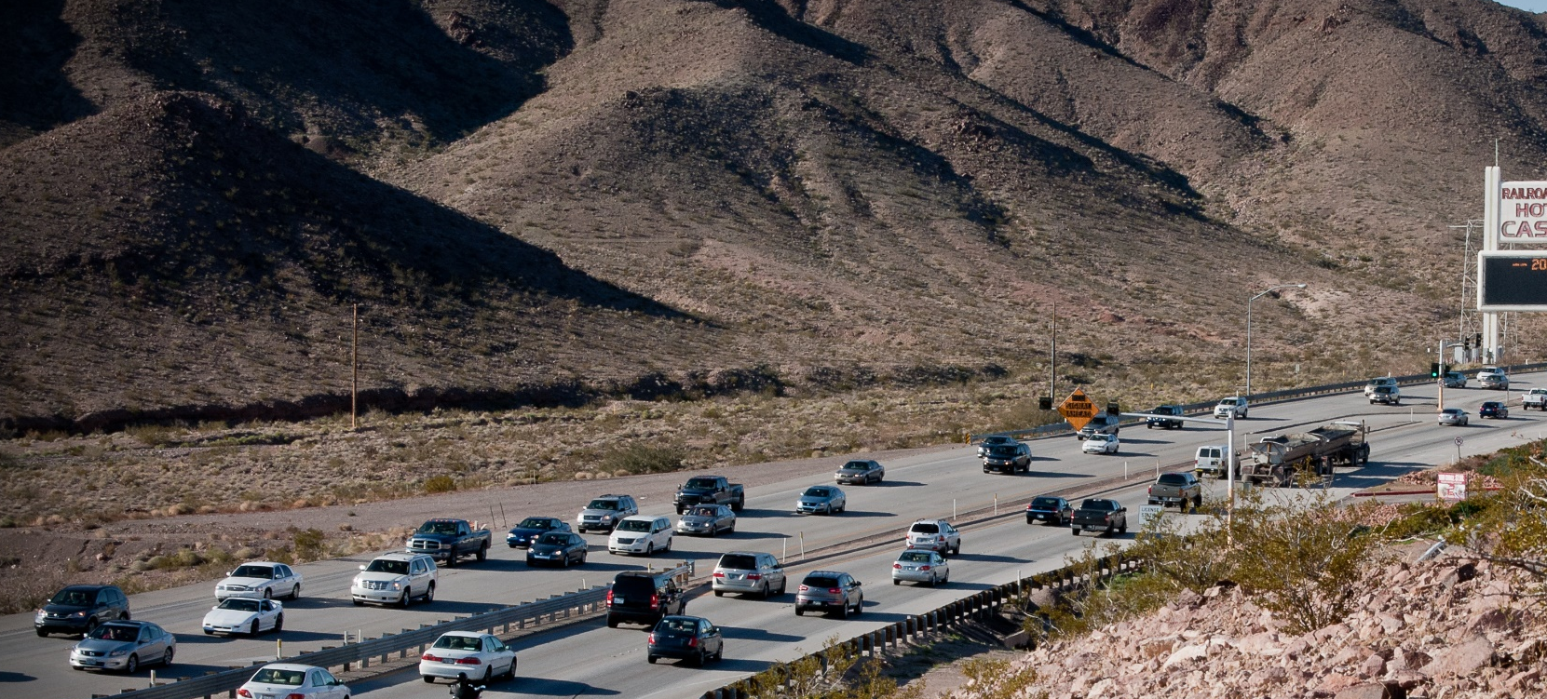

FRI Timeline
2013
2015
2016
AB413
Passed
AB191
Passed
Q5
Passed
Notes:
As AB 359 is regarding the continuation of FRI, I would like to briefly discuss the origination of the program.
In 2013, the Nevada State Legislature, with overwhelming bipartisan support, passed Assembly Bill 413 (AB 413), which enabled the Clark County Board of Commissioners to index the county’s motor vehicle fuel tax to inflation for the period January 1, 2014, through December 31, 2016, if it enacted an ordinance to effectuate the provision of AB 413.
The bill also authorized the County Commission to provide for increases in these taxes subject to a ten-year rolling average of the Producer Price Index for Highway and Street Construction (PPI) that could be no more than 7.8 percent annually.
On September 3, 2013, the Clark County Board of Commissioners approved Ordinance No. 4126, which approved FRI in Clark County and included a 10 cent total cap on increases for the first three years.
In 2015, the Nevada State Legislature passed Assembly Bill 191 (AB 191), which simplified the ballot initiative language and process under AB 413. The legislation gave authority over the decision to institute Fuel Revenue Indexing (FRI) to each county’s voters, rather than placing it as a statewide question on the ballot.
In November 2016, Clark County Question No. 5 was approved by a vote of the people, which extended FRI through December 31, 2026. At the time, FRI was rejected in all other counties, excluding Washoe County, which already had the program in place.
On March 21, 2017, the County Commission amended the 2013 Ordinance (No. 4126) to cap any increase to the FRI to four cents per gallon annually as part of the ballot question.
BACKGROUND: ROADWAY MILESTONES
1965 State Legislation – 1 cent per gal. fuel tax
1990 Ballot Measure – 9 cents per gal. fuel tax (roadway only)
2002 Ballot Measure – 0.25% sales tax (roadway & transit)
2013 State Legislation – Fuel Revenue Indexing
2016 Ballot Measure – Fuel Revenue Indexing 10-yr. extension

Slide 22

Total Projects by Phase
*3rd Qtr
Notes:
As of the second quarter of FY 2024
Since 2014, 658 roadway projects have been started, with 439 of those completed. These are projects made possible by all local funding sources, including Fuel Revenue Indexing, Motor Vehicle Fuel Tax, and Sales Tax.
As of today, we have 115 active design projects and 104 active construction projects.

Slide 23
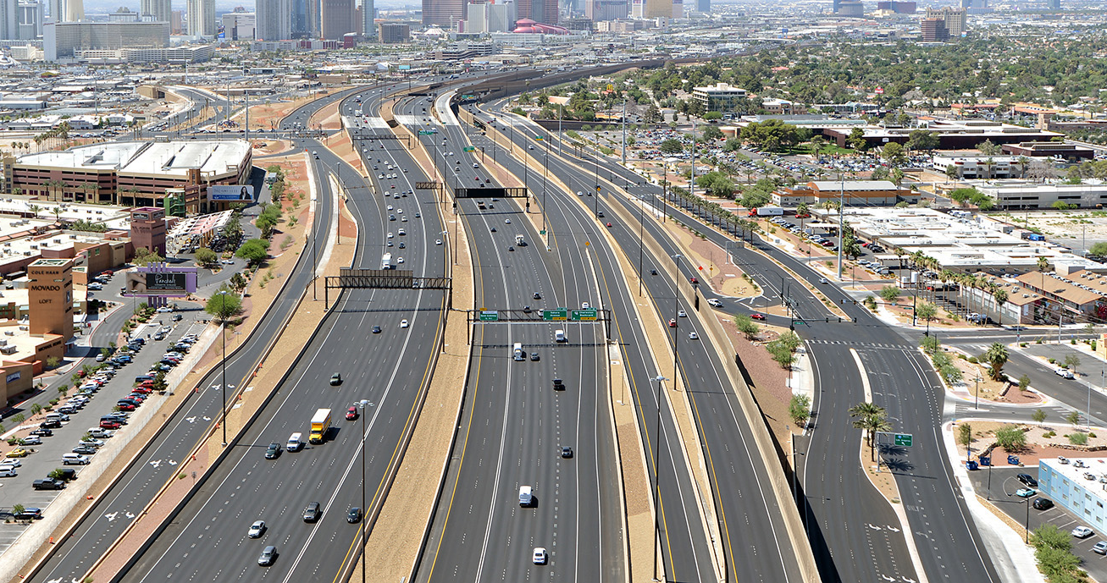




Fuel Revenue Indexing
674
78
$2.6B
18,000
Projects Awarded
Local Small
Businesses
Contracted
Amount
Jobs
Notes:
Let me take a moment to highlight the success of the FRI program.
Since 2014, 674 roadway projects have been started, with 439 of those completed. These are projects made possible by all local funding sources, including Fuel Revenue Indexing, Motor Vehicle Fuel Tax, and Sales Tax.
Through FRI, 78 local small businesses have been put to work, more than $2.6 billion has been awarded in roadway projects, and more than 17,000 jobs have been created (direct, indirect, and induced). This revenue provides the necessary funds for the RTC and local jurisdictions to advance projects that will improve mobility, enhance pedestrian safety, and create jobs to make Southern Nevada a better place to live, work, and play. (Nevada Gas Tax breakdown word doc)
As of the second quarter of FY 2024, the total revenues are more than $2.4 billion
And finally, the roadway projects funded and developed in partnership with the local jurisdictions have created more than 18,000 jobs since 2014.
BACKGROUND
The 10,689 person years of employment is how we calculate the estimated number of jobs FRI has created. One person year of employment is equivalent to the number of hours that an individual would work on a full-time basis for one year. For example, this could be one person working for 2,080 hours or three people working for four months each. The number of individuals jobs would be notably higher as this does not account for partial FTEs.

Slide 24
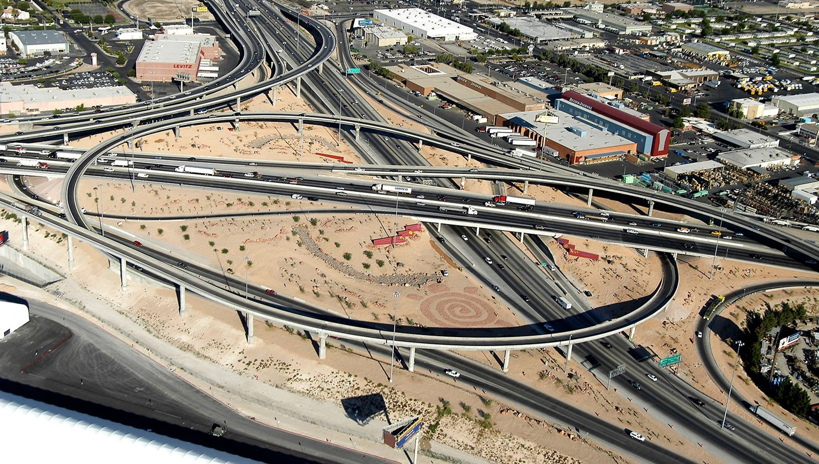
Roadway Funding Challenges
Notes:
Next up, let’s talk about our roads.

Slide 25

Current Nevada Gas Tax Breakdown
72.4 Cents
is collected per gallon of gas in Clark County
Federal
18.4 cents
State
22.1 cents
Clark County
8.8
cents
RTC
23.1
cents
Notes:
That historical background brings us to the current Nevada gas tax breakdown.
Today, 72.4 cents is collected for every gallon of gas sold in Clark County, 52.2 cents through fuel tax and 20.2 cents through FRI.
Of that 72.4 cents, 18.4% goes to the federal government, 22.1% goes to the State of Nevada, 8.8% goes to Clark County, and 23.1% goes to the RTC.
BACKGROUND
Currently, a total of 0.724 is collected per gallon of gas in Clark County.
Of that fuel tax, 0.522 is distributed as follows:
0.090 per gallon to RTC
0.063 per gallon to Clark County
0.185 per gallon to the state
0.184 per gallon to federal
The other portion of the fuel tax, 0.202, is attributed to Fuel Revenue Indexing (FRI), the portion of the gas tax that is tied to inflation. FRI is currently distributed as follows:
0.142 to RTC
0.024 to Clark County
0.036 to the State.
In total, the fuel tax collected per gallon in Clark County is currently distributed as follows:
0.231 per gallon to RTC
0.088 per gallon to Clark County
0.221 per gallon to the State
0.184 per gallon to federal

Slide 26
RTC Fuel Tax Collections
Actual
While Motor Vehicle
Fuel Tax revenue has
remained flat for
more than a decade,
Fuel Revenue Indexing has generated
over $900 million to fund critical roadway projects.
Source: Regional Transportation Commission. Totals include revenue for gasoline and special fuels such as diesel.
Notes:
This slide indicates the success of the FRI program. The dark blue bars represent MVFT and the orange bars represent the additional funding due to the FRI program.
If it was not for the indexing program, fuel tax would have remained flat, and we would not have been able to fund critically needed roadway projects. The FRI program has generated more than $900M.

Slide 27
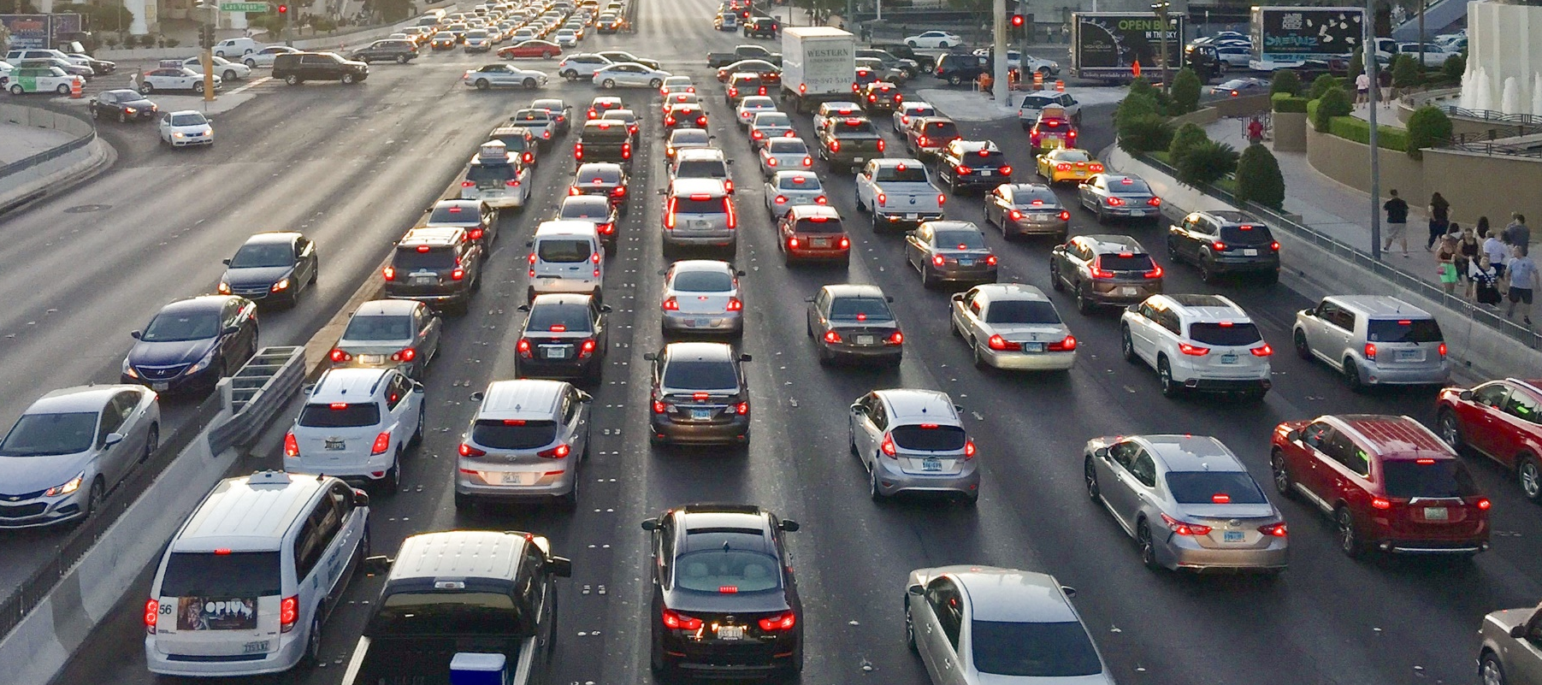


Roadway Funding Challenges Ahead
  FRI Discontinues
  in 2026
  Decline in Taxable Gallons Sold
  No Tax Revenue from
  EV’s

Slide 28
RTC Cash Balance - Roadways
Baseline
Notes:
This slide is a snapshot of our roadway funding through the term of our current 10-year CIP. The bars on the left represent revenues, the dark bars to the right represent expenditures and the purple shaded area behind the bars represent the forecasted cash balance.
We have forecasted the ability to raise enough revenue and have the bonding capacity to cover the local jurisdictions’ 10-year capital improvement program.
At the same time, the nearly $2.2 billion CIP does not include a myriad of additional projects local jurisdictions need to get done. As we move beyond this 10-year program, our financial capacity will diminish if FRI is not extended beyond 2026.
Without the FRI extension, we will only have between $75M to $100M per year in revenues moving forward. To date, local governments have identified an additional $2B of unfunded projects.
BACKGROUND
FY 2023 – issued $300M worth of bonds
FY 2024 - $150M worth of bonds will be issued
Ex: FY33 expenditures over revenues---the purple shaded area represents the cash available to make up the difference.
Will continue to borrow based on feeding need.
Scenario Elements:
Capital expenses include the current encumbrance amount plus projects in the 10-year CIP
Includes $650 million in proceeds from fuel tax revenue bonds (MVFT and FRI)
Includes $815 million in proceeds from sales tax revenue bonds (Q10)

Slide 29
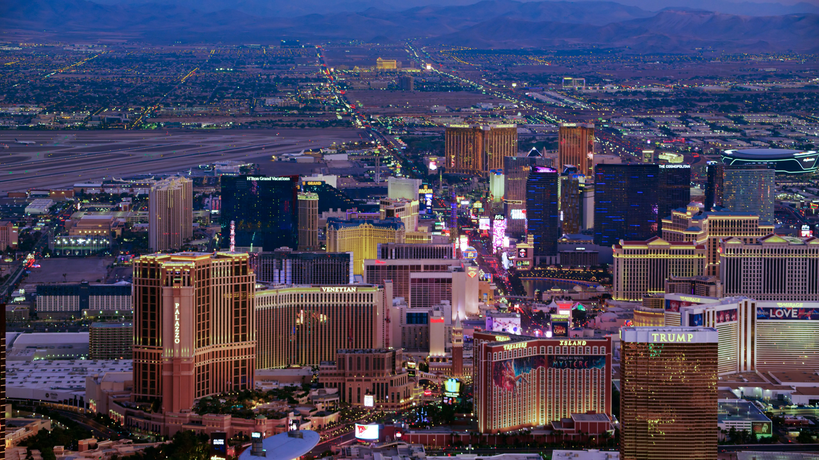
WE KNOW THE CHALLENGES AHEAD,
Let’s find solutions together.
Notes:
The biggest takeaway from today’s presentation is that we have a structural problem in how we fund both roadways and transit, which will result in a crisis for our entire transportation system in the future if we cannot find new revenue sources.
We are committed to using the time we have to work with you, other elected officials, community stakeholders, and residents to review policy and revenue options because it will take a collective, collaborative effort.
Future efforts could include a ballot measure, extension of existing indexing, new revenue sources, or a combination of solutions is most appropriate for maintaining and improving our transportation network.
We are also committed to keeping you apprised as we engage in this crucial process.

Slide 30

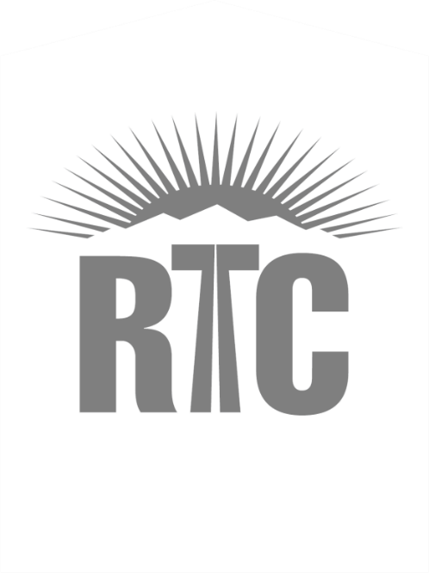





David Swallow, P.E., F.ASCE
Deputy CEO
Regional Transportation Commission
of Southern Nevada
Email: swallowd@rtcsnv.com
Telephone: (702) 676-1616
rtcsnv.com
Notes:
To close, the RTC has been serving our community for more than 30 years. And again, we’re excited to work with you and continue improving the quality of life for Southern Nevadans, and we appreciate your time today.

